Slide 1

Wel- Come
Credit Card Sales Analysis

Slide 2
Project Overview
1. The analysis examines customer behavior across credit card categories,
focusing on utilization ratios and transaction volumes.
2. It identifies customers with high utilization ratios and ranks the top customers
by total transaction amounts each quarter.
3. The analysis tracks the contribution of annual fees by card categories and monitors
transaction trends over time.

Slide 3
CREDIT_CARD Table:
CLIENT_NUM: Unique identifier for each customer.
Card_Category: Type of credit card.
Annual_Fees: Yearly fee charged for the card.
Activation_30_Days: Whether the card was activated within 30 days of issuance.
Customer_Acq_Cost: Cost incurred for acquiring the customer.
Week_Start_Date: Start date of the week for the data entry.
Week_Num: Week number in the year.
Qtr: The fiscal quarter in which the data was recorded.
current_year: The current year for the record.
Credit_Limit: Maximum amount of credit available on the card.
Total_Revolving_Bal: Total balance carried forward month-to-month.
Total_Trans_Amt: Total amount spent using the card in each period.
Total_Trans_Vol: Total number of transactions made.
Avg_Utilization_Ratio: Average percentage of credit limit used.
Use Chip: Card usage type (online . Swipe , chip)
Exp Type: Type of expenditure for transaction.
Interest_Earned: Total interest earned by the credit card issuer.
Delinquent_Acc: Number of delinquent (due or pending payment) accounts associated with the client.

Slide 4
CUSTOMER Table:
CLIENT_NUM: Unique identifier for each customer.
CUSTOMER: Name or identifier of the customer.
GENDER: Gender of the customer.
DEPENDENT: Number of dependents the customer has.
EDUCATION: Education level of the customer .
MARITAL_STATUS: Marital status of the customer .
STATE_CD: The state code where the customer resides.
ZIPCODE: Postal code of the customer’s address.
CAR_OWNER: Whether the customer owns a car.
HOUSE_OWNER: Whether the customer owns a house.
PERSONAL_LOAN: Whether the customer has a personal loan .
CONTACT: Contact details of the customer.
CUSTOMER_JOB: Customer’s job or occupation.
INCOME: Annual income of the customer.
CUSTOMER_SATISFACTION_SCORE: Score representing the customer’s satisfaction level.

Slide 5
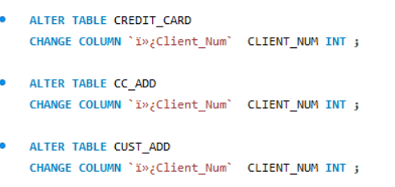
Renaming Column Names in SQL
SQL Query

Slide 6
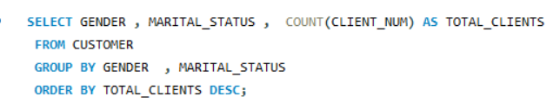
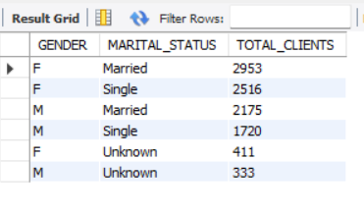
Q1: Write a SQL query to retrieve the total number of customers, grouped by their GENDER and MARITAL STATUS.
SQL Query
Output

Slide 7
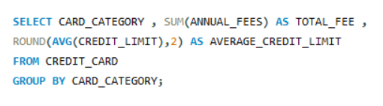
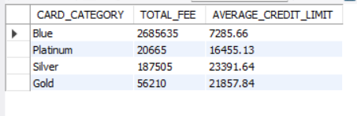
Question 2 : Calculate the total Annual Fees and average Credit Limit for each Card Category
SQL Query
Output

Slide 8
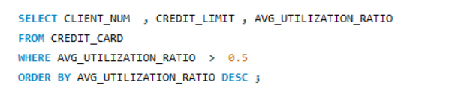
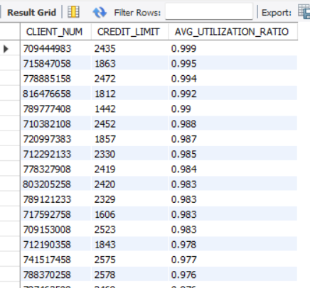
Question 3 : Find customers with an Avg Utilization Ratio greater than 0.5 and list their CLIENT NUM and Credit Limit.
SQL Query
Output

Slide 9
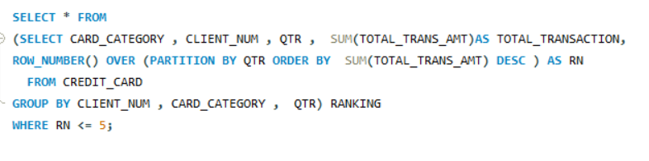
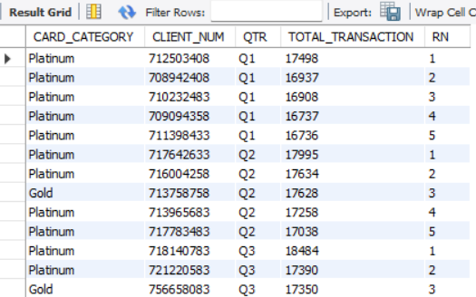
4 Question: Find the top 5 customers with the highest Total Trans Amount in each quarter
SQL Query
Output

Slide 10
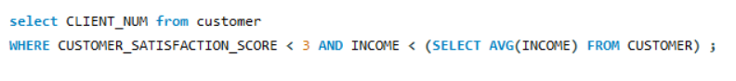
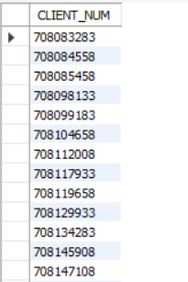
QUESTION 5: Identify customers whose CUSTOMER_SATISFACTION_SCORE is below 3 and whose income is below the average income of all customers
SQL Query
Output

Slide 11
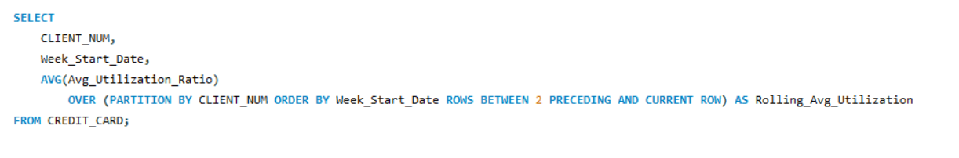
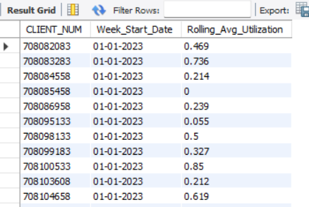
QUESTION 6 :Calculate the rolling average of Avg Utilization Ratio over the past 3 weeks for each customer
SQL Query
Output

Slide 12
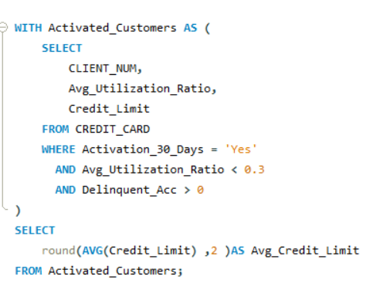
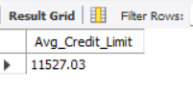
Question 7 : "Identify customers who have low credit card utilization (below 30%), have at least one delinquent account, and have activated their credit card in the last 30 days and find average credit limit for this customers
SQL Query
Output

Slide 13
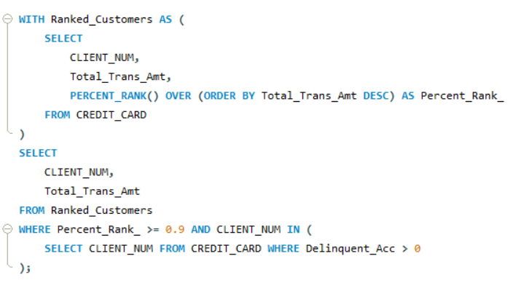
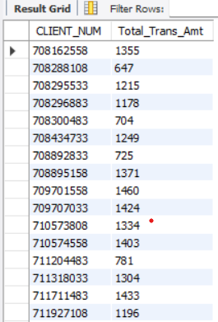
Question 8 : Identify customers with significant transaction amounts who also have delinquent accounts.
SQL Query
Output

Slide 14
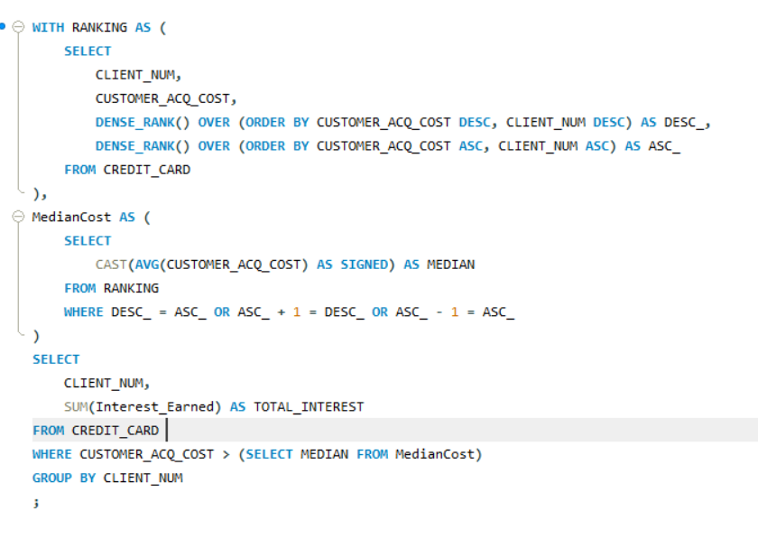
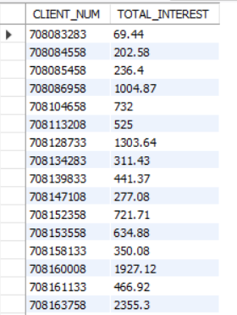
Question 9 : calculate the total interest earned by customers whose acquisition cost is above the median value
SQL Query
Output

Slide 15
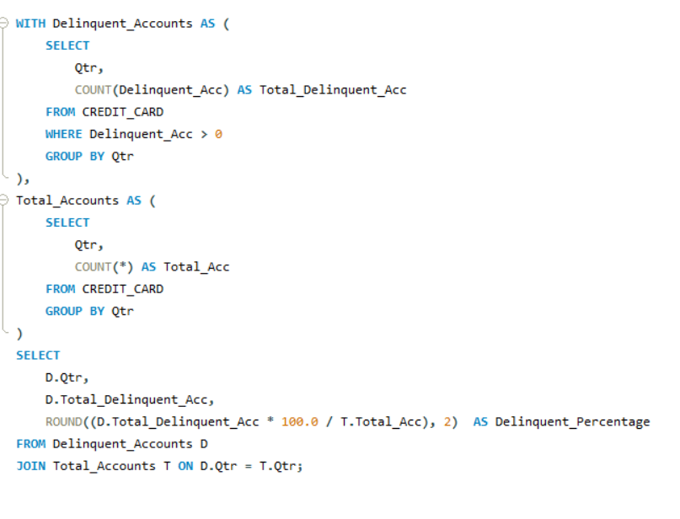
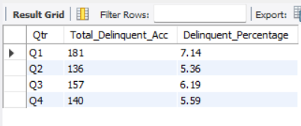
Question 10 : Identify the percentage of delinquent accounts in each quarter
SQL Query
Output

Slide 16
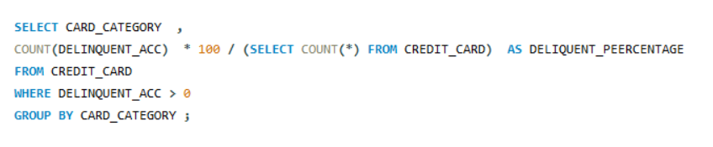
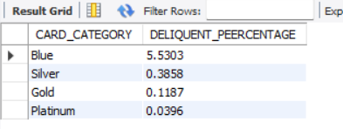
Question 11 : For each Card Category, calculate the delinquency rate (number of delinquent accounts divided by total accounts).
SQL Query
Output

Slide 17
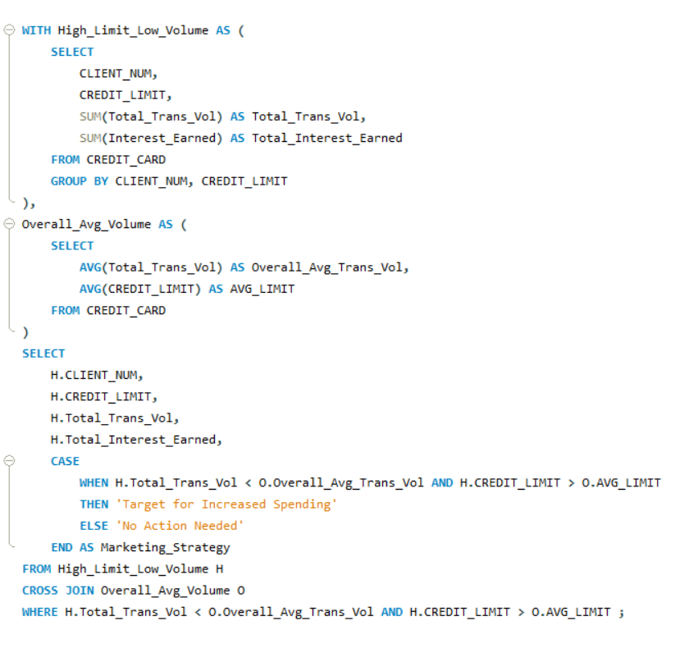
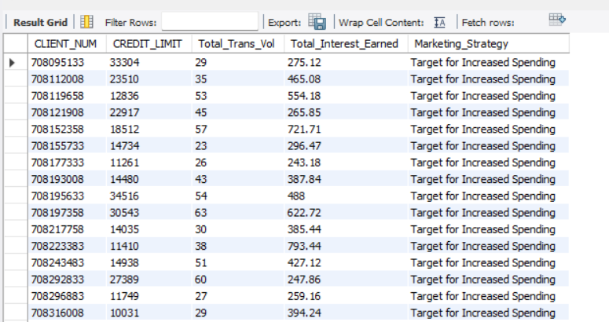
Question 12 : Identify customers who have a high credit limit but low transaction volume, and calculate the total interest earned for this segment.
SQL Query
Output

Slide 18
INSIGHTS
1 .Gender and Marital Status Distribution:
A) Female clients outnumber male clients in both married (2953 females vs. 2175 males) and single
(2516 females vs. 1720 males) categories.
B) "Unknown" marital status is a relatively small category, with 411 females and 333 males, indicating a manageable
group for further analysis or clarification.
2. Card Categories and Financial Metrics:
A) Blue cards generate the highest total fee of $2,685,635 with an average credit limit of $7,285.66, indicating strong
utilization despite a moderate credit limit.
B) Platinum cards have the lowest total fee of $20,665 but a significantly higher average credit limit of $16,455.13,
suggesting a more exclusive cardholder base with potentially lower transaction volumes.
C)Silver and Gold cards fall in between with Silver having a higher average credit limit ($23,391.64) than Gold ($21,857.84),
but lower fees compared to Blue.
3.Credit Utilization and Risk:
Clients with high utilization ratios (above 0.9) are at risk of overleveraging their credit, which can lead to financial strain or
defaults. Monitoring these clients can help in mitigating potential credit risks.

Slide 19
4. Top Cardholders by Transaction Volume:
Platinum cardholders consistently dominate the top 5 spots for highest transaction amounts across all quarters, with the highest transactions peaking at $18,484 in Q3.
5. Customer Satisfaction and Income:
The analysis shows a significant portion of customers with low satisfaction scores (below 3) and income below the average, suggesting a potential area for improvement in customer experience and targeted marketing campaigns to improve engagement.
6 .Credit Utilization Trends:
The rolling average of credit utilization reveals diverse client behaviors, from consistent low utilization to periodic spikes. This indicates that some clients may be prone to increased spending during specific periods, offering opportunities for targeted interventions.
7. Activated Customers with Low Utilization:
Customers with low utilization (<0.3) and delinquent accounts have an average credit limit of $11,527.03, suggesting that despite under-utilization, these clients are at risk of delinquency and need closer monitoring.
8. High-Spending Delinquent Clients:
Clients who fall in the top 10% of transaction volumes but also have delinquent accounts require special attention. These clients may present a higher risk due to the combination of high spending and delinquency, warranting deeper analysis of their credit behavio

Slide 20
Interest Earned by Clients:
Clients with higher acquisition costs tend to generate moderate interest ($100 to $1000), with some high-value clients earning significantly higher interest, like $3163.82. This indicates a small number of customers contributing disproportionately to the overall interest earned.
Delinquency Trends by Quarter:
Q1 saw the highest delinquency rate at 7.14%, while Q2 had the lowest at 5.36%. Q3 and Q4 showed slightly higher rates at 6.19% and 5.59%, respectively, suggesting fluctuations in credit risk over the year.
Delinquency Rates by Card Category:
Blue cardholders had the highest delinquency percentage at 5.53%, while Silver, Gold, and Platinum card categories had much lower rates, indicating that high-fee cardholders might be more prone to delinquency.
Target for Increased Spending:
The marketing strategy identified high-limit, low-volume clients for targeted engagement. These clients, despite having high credit limits, are underutilizing their available credit, presenting an opportunity for interventions that encourage increased spending.

Slide 21
CONCLUSION
Client Demographics: Female clients outnumber male clients, with many earning below average and dissatisfied, presenting an opportunity for targeted improvement in customer experience.
Card Category Analysis: The Blue card category generates the highest fees, while the Platinum card offers higher credit limits but generates lower fees.
Credit Utilization Risk: Clients with high credit utilization are at a greater risk of financial strain, suggesting the need for closer monitoring of such accounts.
Transaction Volume: Platinum cardholders consistently lead in high transaction volumes, but delinquency rates are higher among Blue card holders.
Targeted Marketing: High-limit, low-transaction clients present an opportunity to boost spending by targeting them with personalized marketing strategies.
Focus Areas: Concentrating on credit risk management, improving customer satisfaction, and implementing targeted marketing strategies will help optimize financial performance.

